Slide 1
Cosmos DB (Planet Scale DB)
Pravin

Slide 2
What and why of Cosmos DB

Slide 3
What is cosmos DB?
It is a fully managed database service with turnkey global distribution and transparent multi-master replication.
You can run globally distributed, low latency operational and analytics workloads and AI on transactional data within your database.

Slide 4
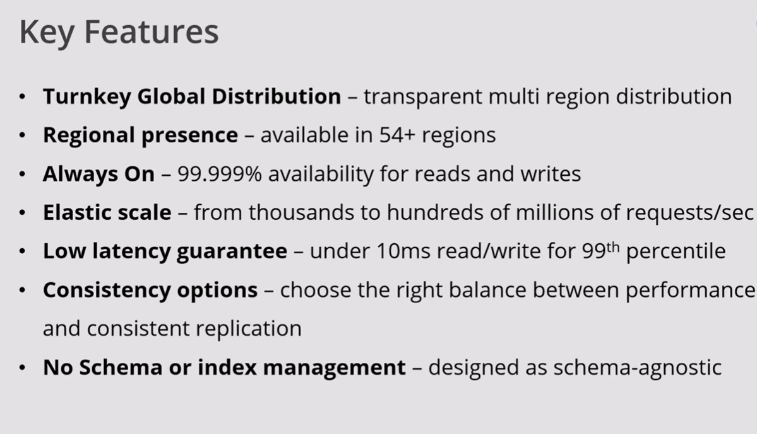
Key features

Slide 5
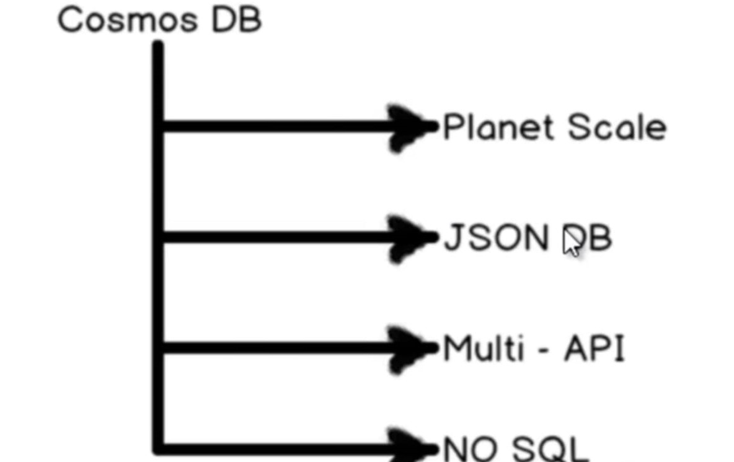
Cosmos DB basics

Slide 6
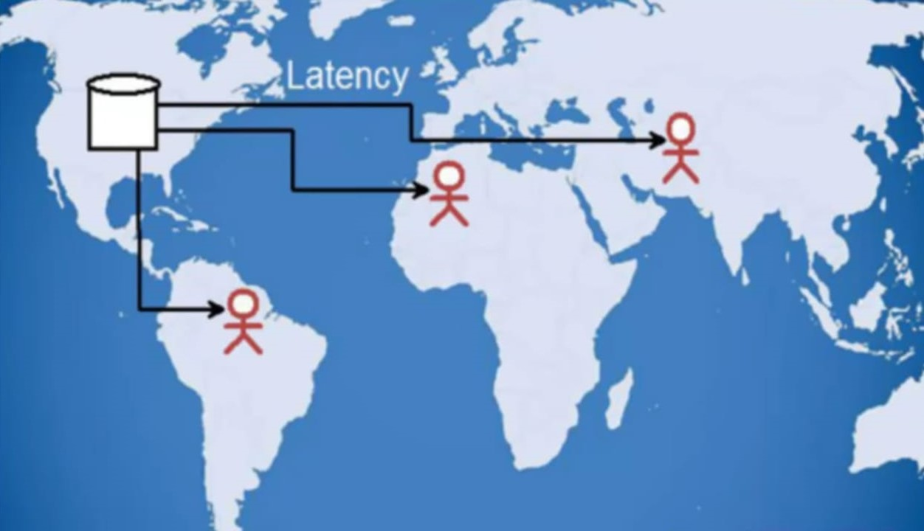
DB Latency problem

Slide 7
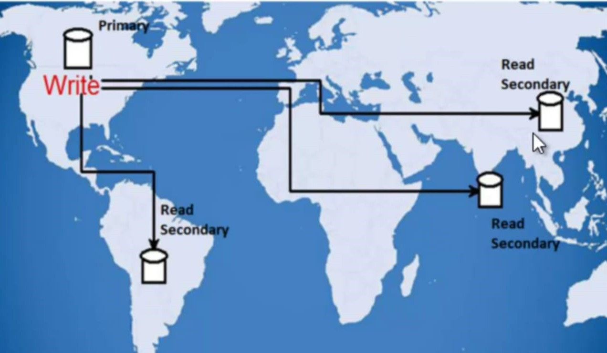
DB Latency problem

Slide 8
Consistency Problems with Planet scale DBs

Slide 9
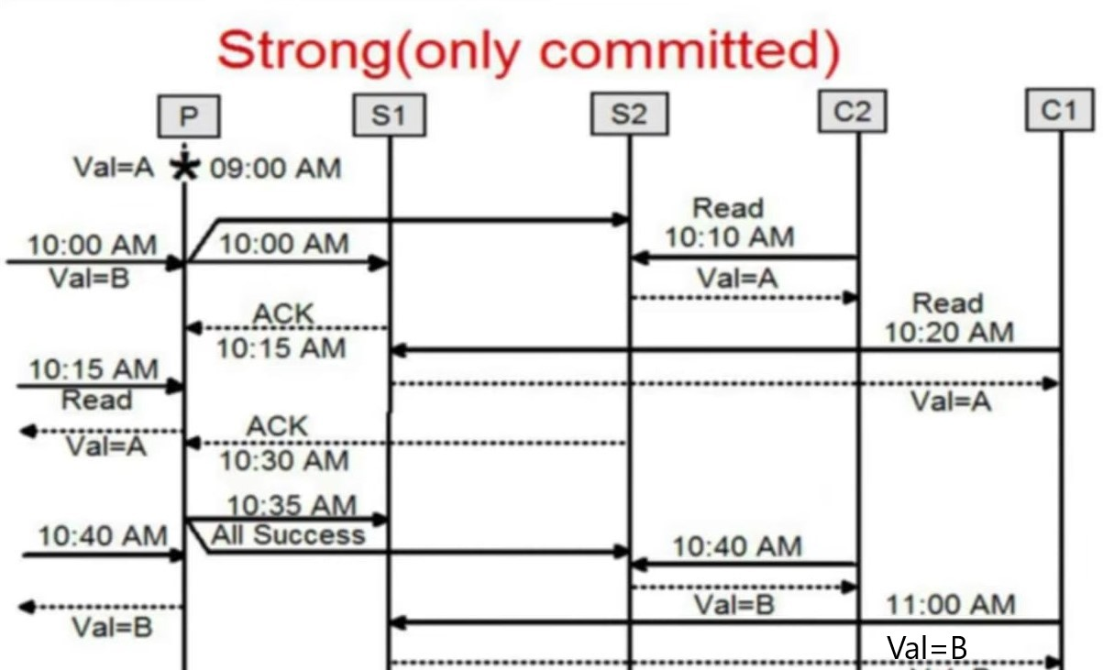
Strong consistency Explained

Slide 10
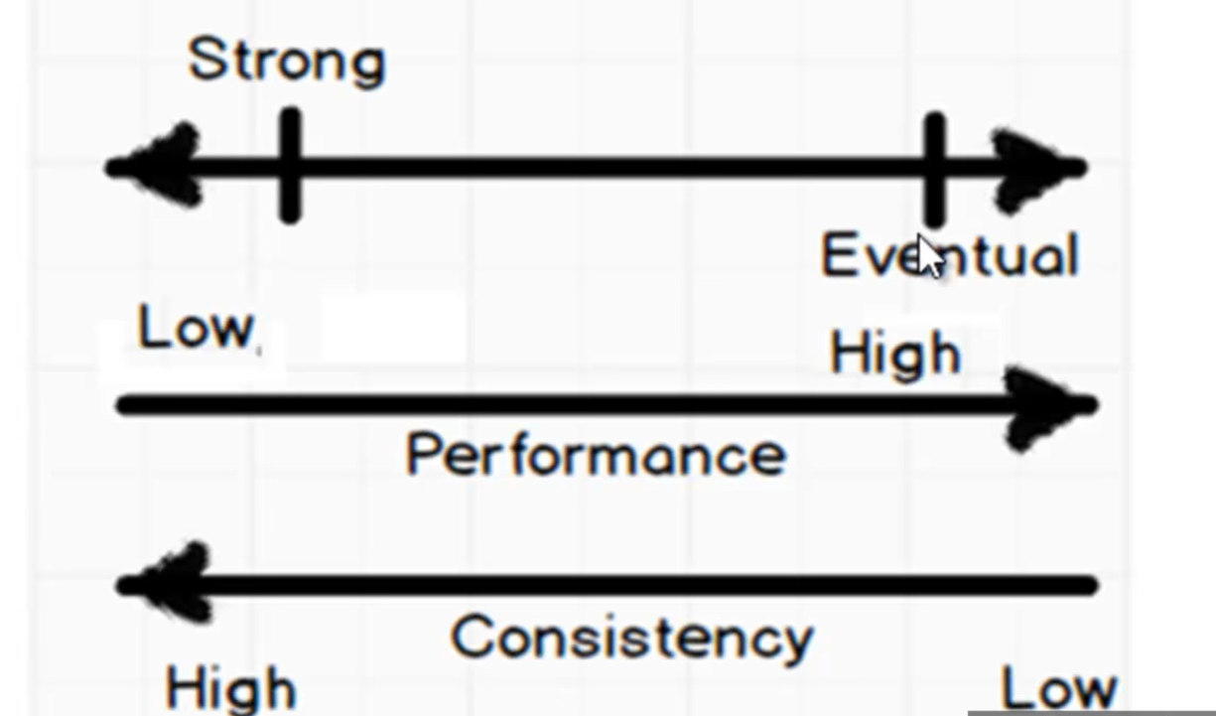
Tradeoffs with consistency vs performance

Slide 11
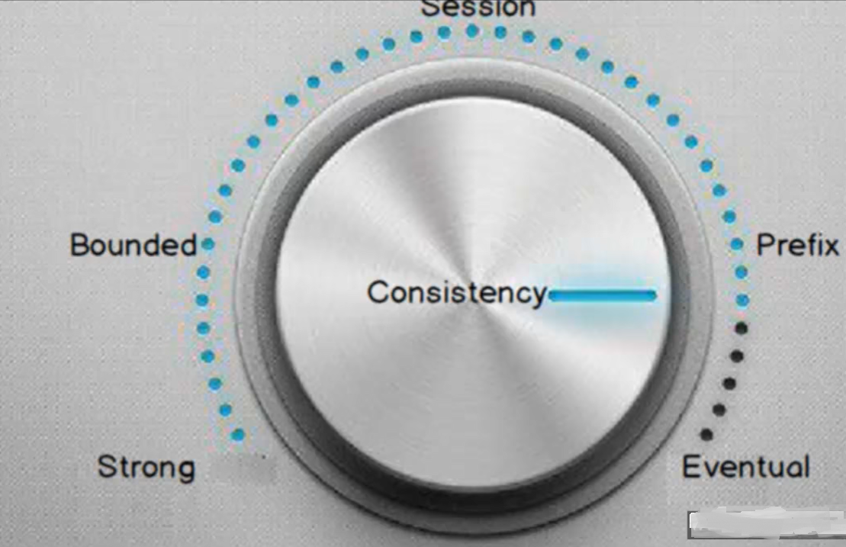
Choices for Cosmos DB

Slide 12
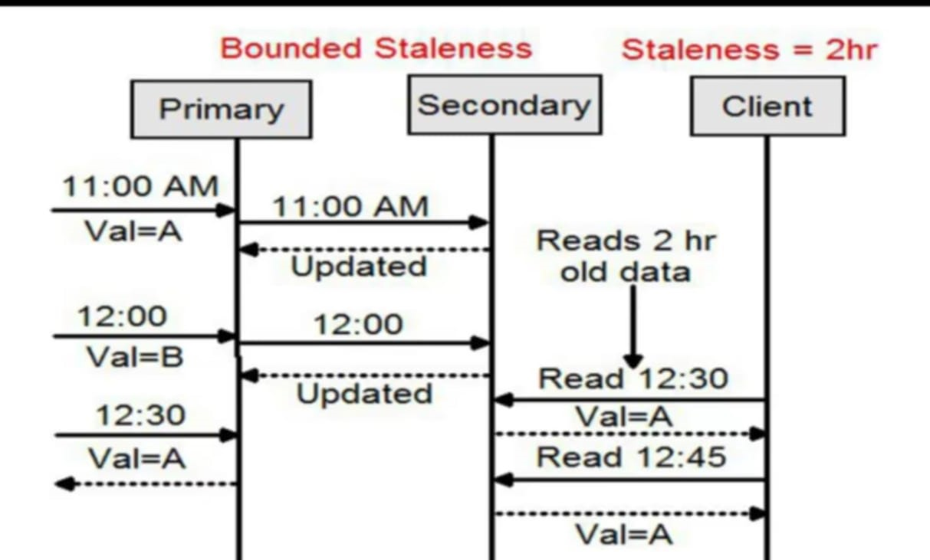
Bounded Staleness

Slide 13
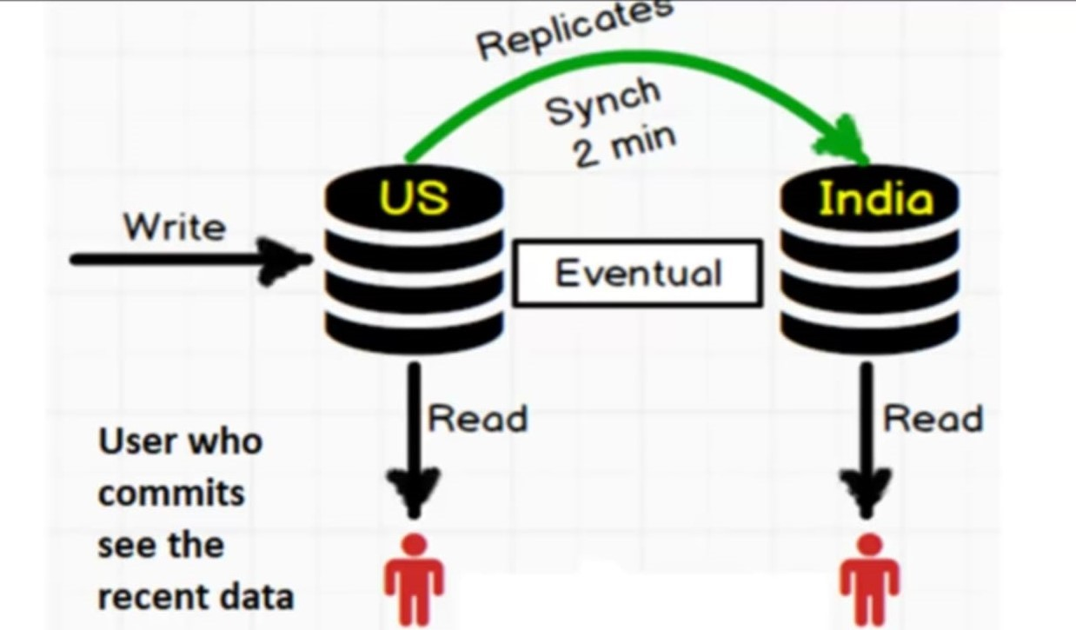
Session consistency

Slide 14
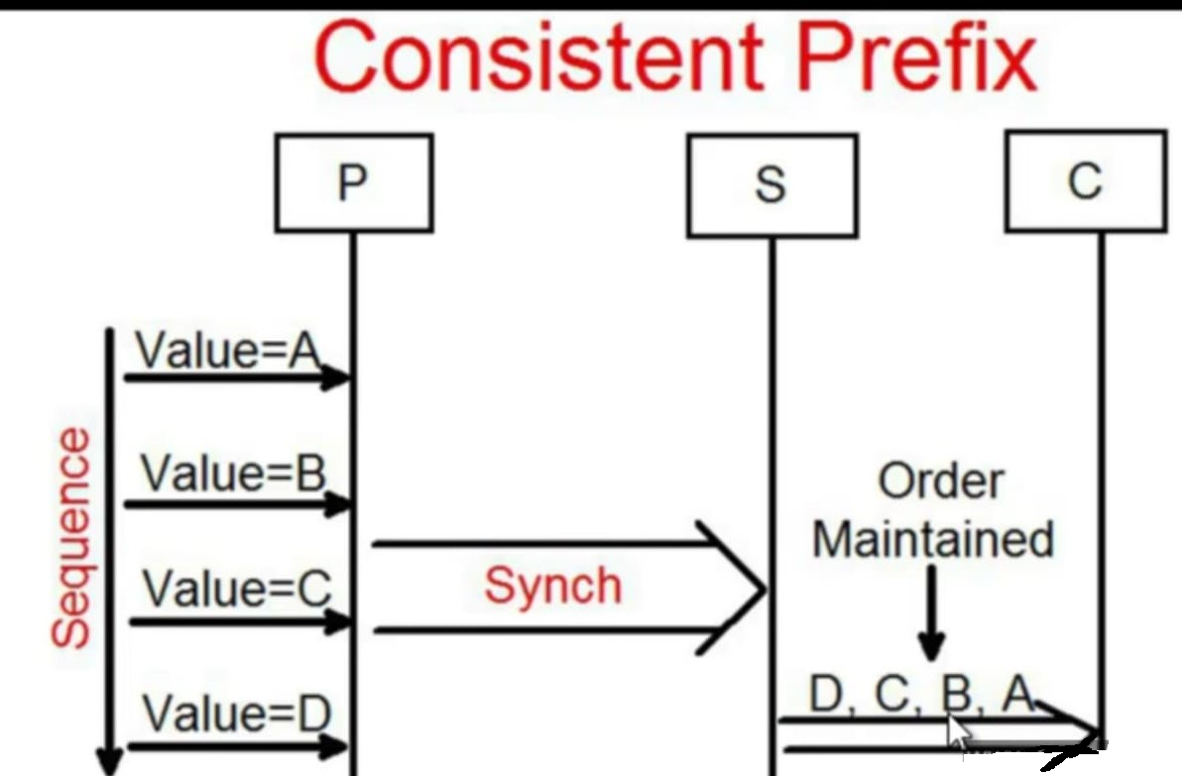
Consistent Prefix

Slide 15
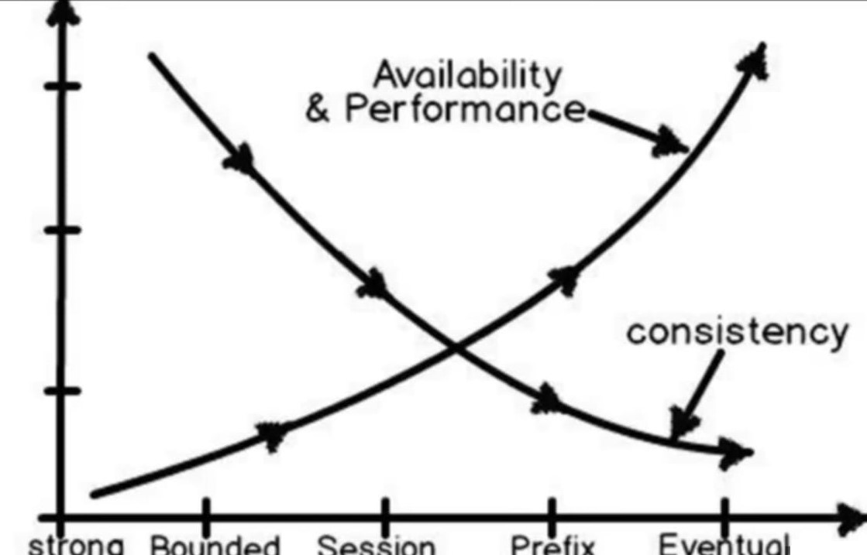
Choice to be made

Slide 16
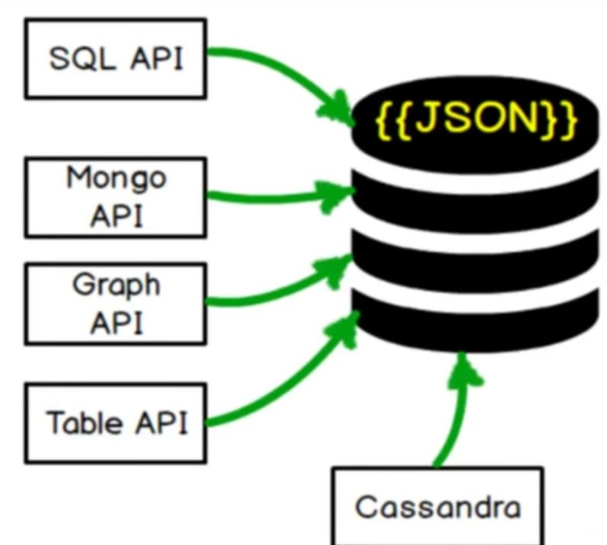
Cosmos DB

Slide 17
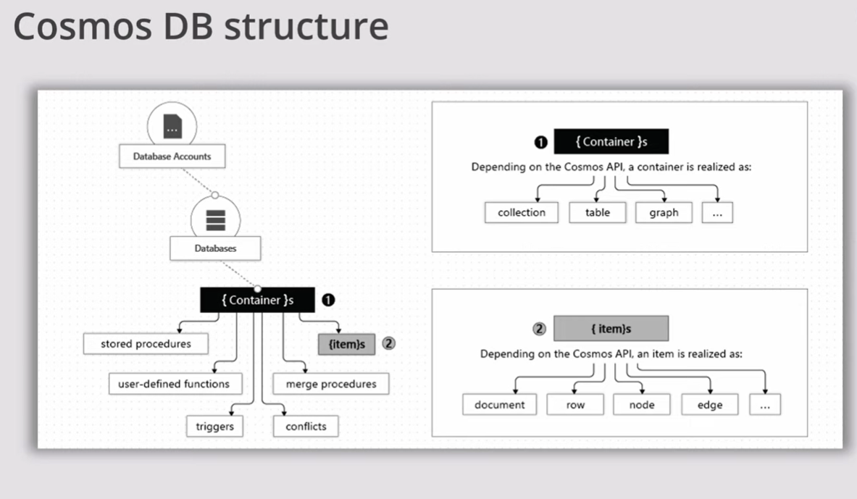
Cosmos DB Structure
Notes:
Think about containers to be like tables and items to be like rows of data.
Containers contains different things depending on what API you choose it. It contains collection, table, graph etc.

Slide 18
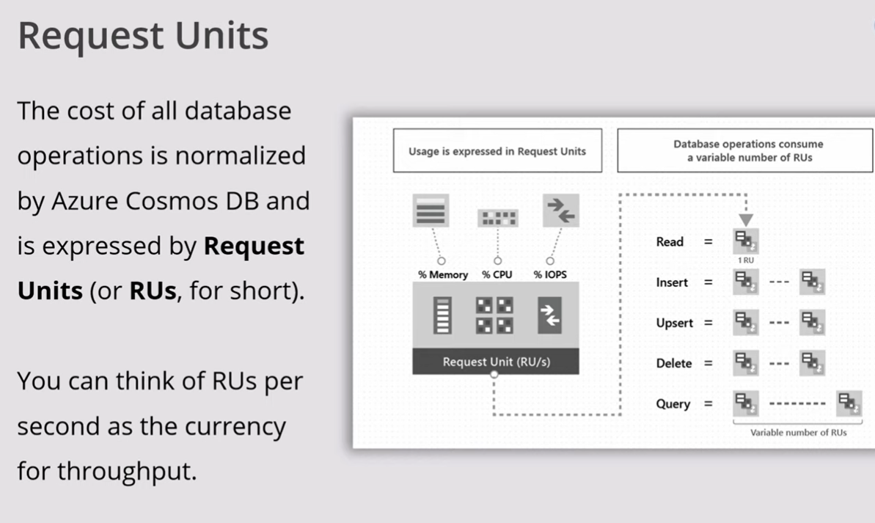

Slide 19
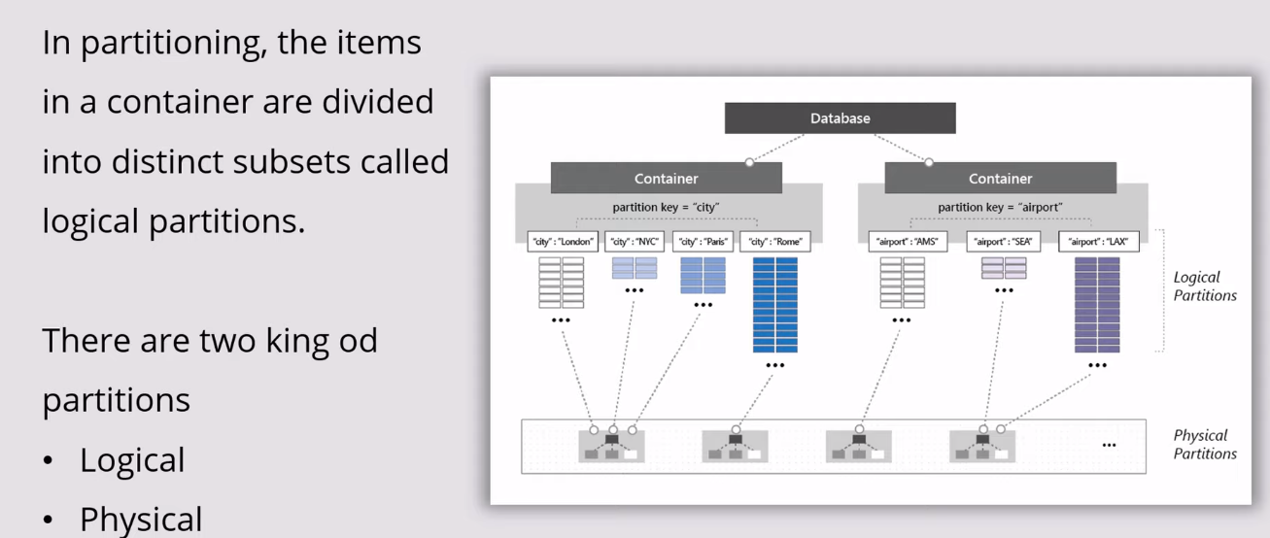
Partitions
Notes:
Here one of the most critical things is to designing partitions appropriately as the performance is going to affect accordingly. After you create your database its difficult to change the partitions. You will have to recreate the containers and just reupload your data. The physical partition is not residing in cosmos db engine but resides on separate drive, etc.

